Slide 1
Vaping Use and Environmental Review: Analy High School
University of San Francisco, Master of Public Health Policy
Cynthia Pina
May 15, 2023

Slide 2
Agenda
Problem
Review
Results
Conclusion
Recommendation
Questions

Slide 3
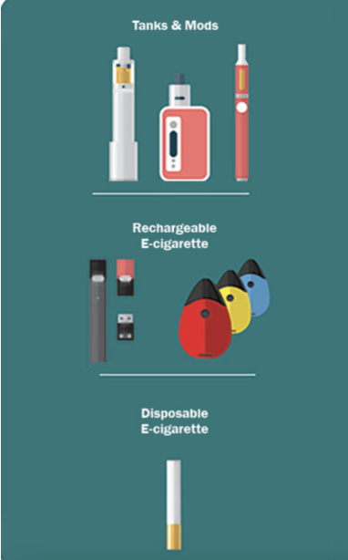
Public Health Problem
8 in 10 students report using electronic cigarettes (ECs or Vapes) in the United States (CDC, 2022).
ECs are a recent innovation to help the cessation of cigarette use, however, they expose users to similar risks of tobacco cigarettes (Prasedya et al, 2020).
The liquid in EC is heated into an aerosol often mislabeled as vapor.
Vaping use of nicotine and cannabis negatively affects sleep, concentration, memory, and mental health (Jacobus & Tapert, 2014).
Amplifies anxiety and depression
Tobacco is the number one littered item on the planet which ends up in waterways or the environment (WHO, 2022).
In Sonoma County, vape pens account for 70 tons of annual waste in landfills (Zero Waste Sonoma, 2022)

Slide 4
Review
GHAC Strategic Goal:
To continue to support the efforts of Tobacco Free Sonoma County Community Coalition (TFSCCC) to use the Sebastopol experience and model program in working toward the goal of a tobacco free Sonoma County.
Project Overview:
Work with Analy High School of Sebastopol to understand student vaping use and environmental awareness of vaping waste
Project Deliverables:
Survey
Report Analysis
Graphic

Slide 5
Review Project Deliverables
Pilot Survey
Developed Pilot Survey with Impact Sonoma and TFSCCC
10 questions
QR code for access
Analy High School Campus Assessment
January 20, 2023
Pilot conducted with Leadership Class (25 students)
Campus tour with Stacy Murtha and David Cary
Reviewed smoke sensors installed in bathrooms

Slide 6
Review Project Deliverables
Pilot Analysis
25 responses
52% of leadership class used a vaping product at least once
12% reported cravings or difficulty reducing use
Modified questions to include demographics, cannabis use, media advertisements, and environmental impact
Main Survey Launch
March 3, 2023
14 questions
Emailed with QR code
73 responses collected out of 1,450 student body
5% response rate
11 students skipped a question throughout the survey
62 valid responses collected

Slide 7
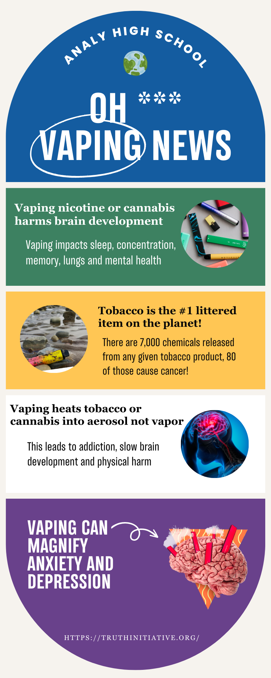
Review Project Deliverables

Slide 8
Results Project Deliverables
Demographics
7 freshmen, 1 sophomore, 22 juniors, 43 seniors
2% Native Hawaiian or other Pacific Islander
5% Asian or Asian American
6% American Indian or Alaskan Native
8% Black or African American
9% multiple ethnicities
24% Hispanic or Latinx
65% White or Caucasian

Slide 9
Results Project Deliverables
Responses
30% reported having used a vaping product (nicotine, marijuana, or other) at least once
15% of those have used a vaping product within the last 30 days, 4% at least 20-30 days in the month
20% reported the people they live with smoke or vape
23% believed no risk occurred from vaping
Students reported that they obtain vape pens through their friend or a “plug”

Slide 10
Results Project Deliverables
Responses
32% did not know about the environmental impact of vaping
45% of students recalled seeing vaping advertisements

Slide 11
Conclusion
This assessment aimed to understand the prevalence of vaping, influences, and environmental awareness among Analy High School students.
The success of this survey was impacted by the virtual access compared to in-person responses.
May not be used to inform policy (nongeneralizable), but is useful for future engagement strategies to gain a greater impact and insight into adolescent users
Recommendation: In-person engagement for Analy High School's vaping prevention and intervention tools is needed for improved outreach
Further, it is important to emphasize interpersonal and individual influences for a positive intervention.
i.e. Socio ecological model - social circle (peers), relationships, family, personal health, income, etc.
Adolescents using vape pens at Analy High School must be intervened through interpersonal and community building, as well as physical informational materials.

Slide 12
Thank you GHAC Board Members! Please let me know if you have any questions. If you would like to connect further, please email me at cnpina@usfca.edu

Slide 13
Resources
CDC (2022, March 11). Surveillance Summaries. Centers for Disease Control and Prevention. https://www.cdc.gov/mmwr/volumes/71/ss/ss7105a1.htm?s_cid=ss7105a1_w
CDC (2022, October 6). More than 2.5 Million Youth Reported E-Cigarette Use in 2022. Centers for Disease Control and Prevention. https://www.cdc.gov/media/releases/2022/p1007-e-cigarette-use.html
Jacobus, J., Tapert, S. F. (2014). Effects of Cannabis on the Adolescent Brain. National Library of Medicine, 20(13), 2186-2193. https://www.ncbi.nlm.nih.gov/pmc/articles/PMC3930618/
Prasedya, E. S., Ambana, Y., Martyasari, N., Aprizal, Y., Nurrijawati, & Sunarpi (2020). Short-term E-cigarette toxicity effects on brain cognitive memory functions and inflammatory responses in mice. PubMed Central, 36(3), 267-273. https://doi.org/10.1007/s43188-019-00031-3
Seitz, C. M., & Kabir, Z. (2018). Burn injuries caused by e-cigarette explosions: A systematic review of published cases. National Library of Medicine, 4(32). https://doi.org/10.18332/tpc/94664
Zero Waste Sonoma (2022, July 15). Waste Characterization Study 2022 Final Report. Sonoma County Waste Management Agency. https://zerowastesonoma.gov/uploads/reports/ZWS-WCS-Final-Report-20Jul2022.pdf
WHO (2022, May 31). WHO raises alarm on tobacco industry environmental impact. World Health Organization. https://www.who.int/news/item/31-05-2022-who-raises-alarm-on- tobacco-industry-environmental-impact

